Slide 1
跟着Kevin学英语(2)
认识字母表
D M L T S B N W

Slide 2
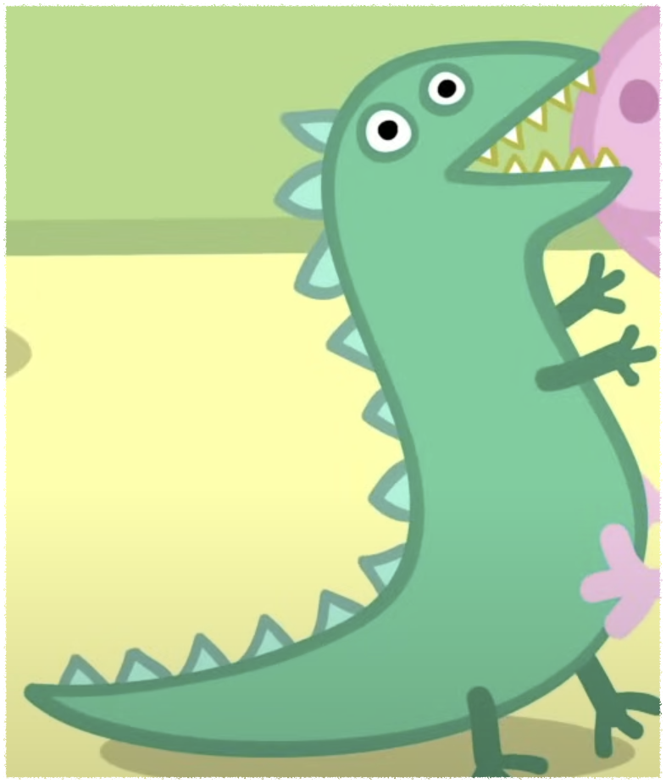
D d
Dinosaur
Notes:
George’s favorite toy is Mr dinosaur

Slide 3
M m
Mr
Notes:
George’s favorite toy is Mr dinosaur

Slide 4

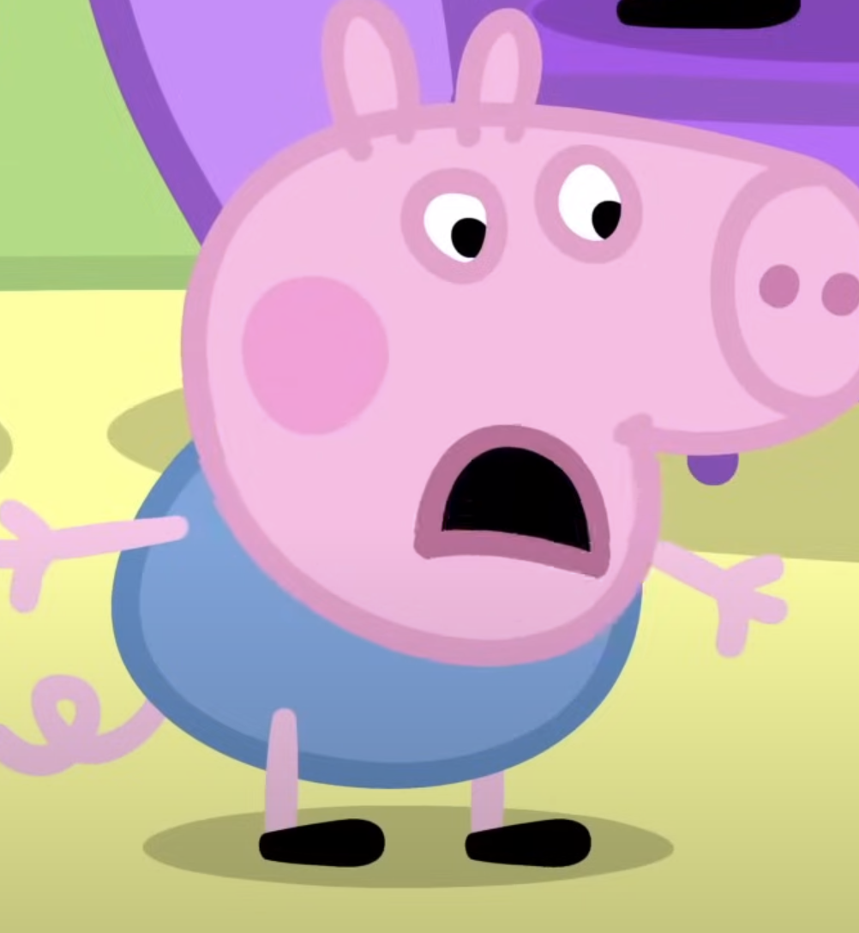
L l
Lost
Notes:
George has lost Mr dinosaur

Slide 5
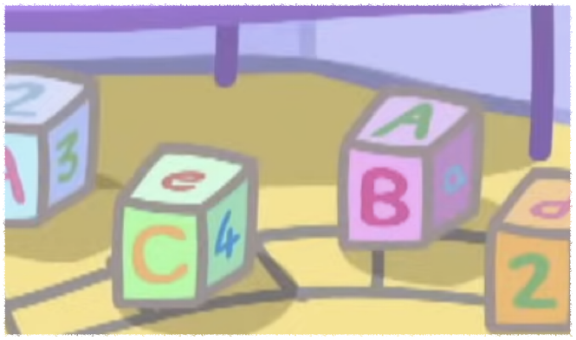
T t
Toy
Tree
Notes:
George’s favorite toy is Mr dinosaur

Slide 6
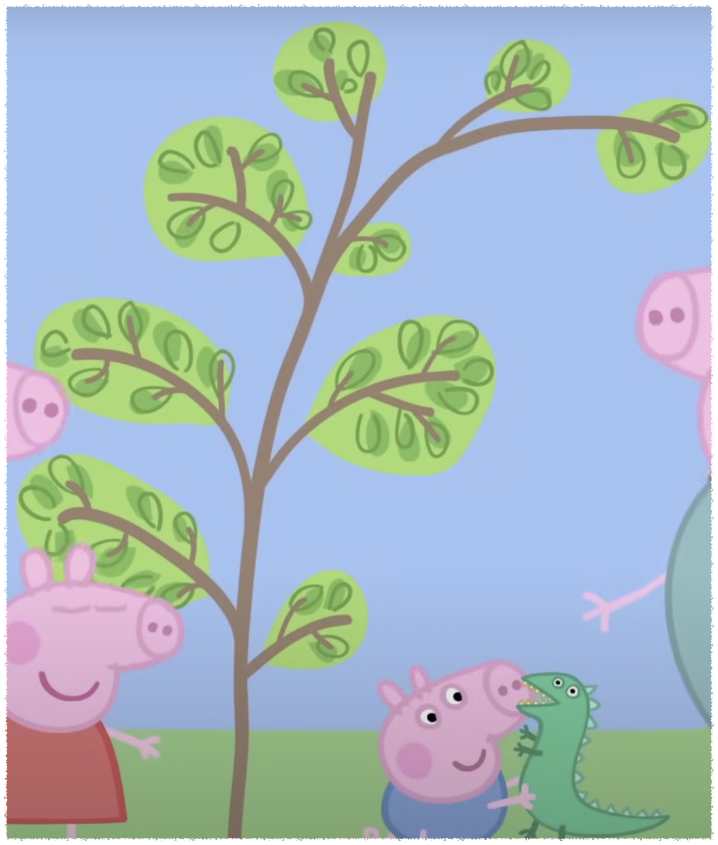
T t
Toy
Tree
Notes:
Maybe it’s not a good idea to play with dinosaur near trees

Slide 7
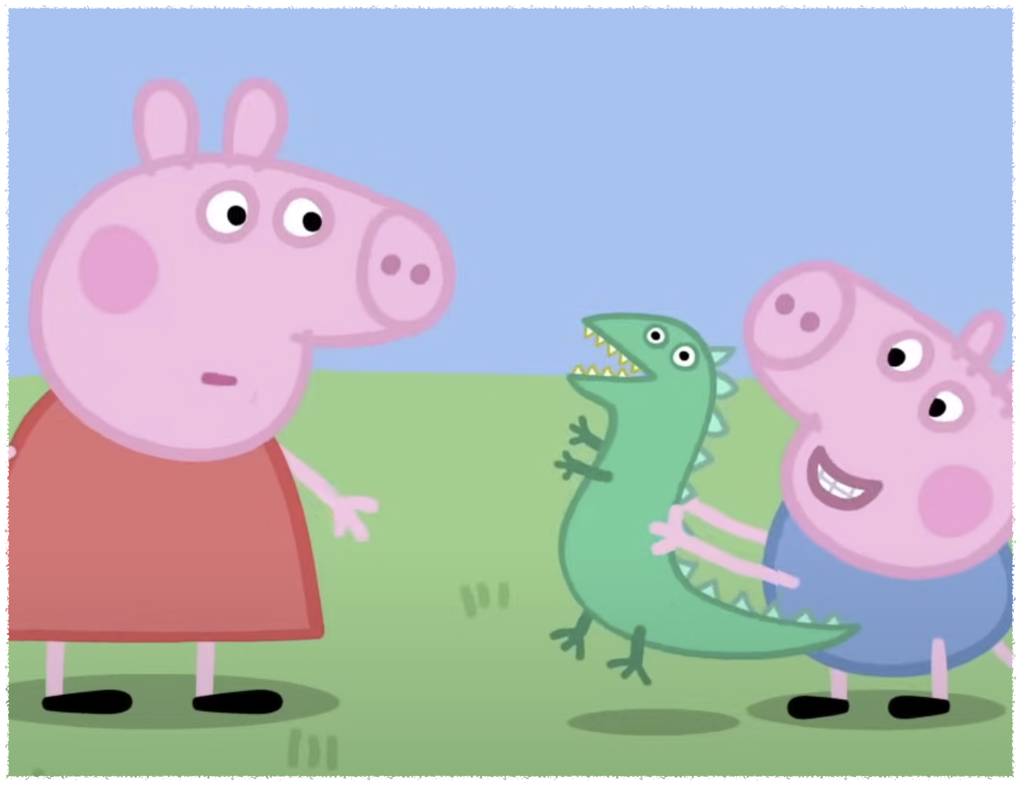
S s
Scare
Notes:
Sometimes George likes to scare Peppa with Mr dinosaur

Slide 8
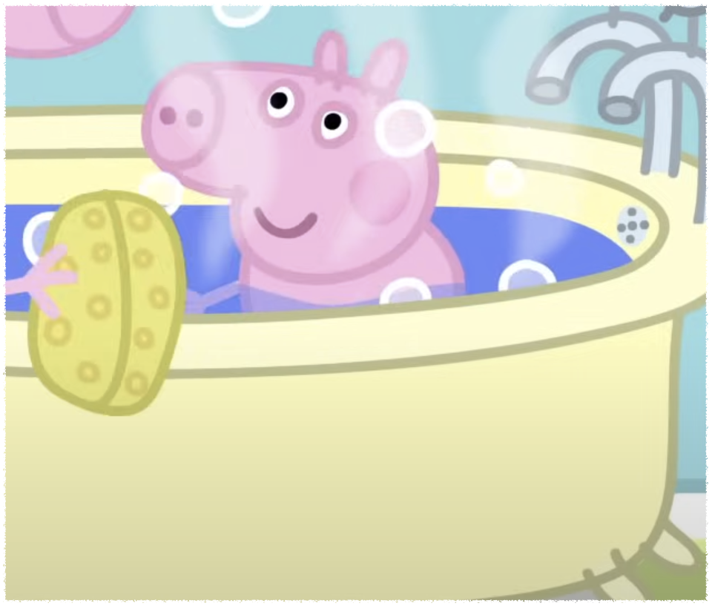
B b
Bath
Bed
Notes:
At bath time,George shares his bath with Mr dinosaur

Slide 9
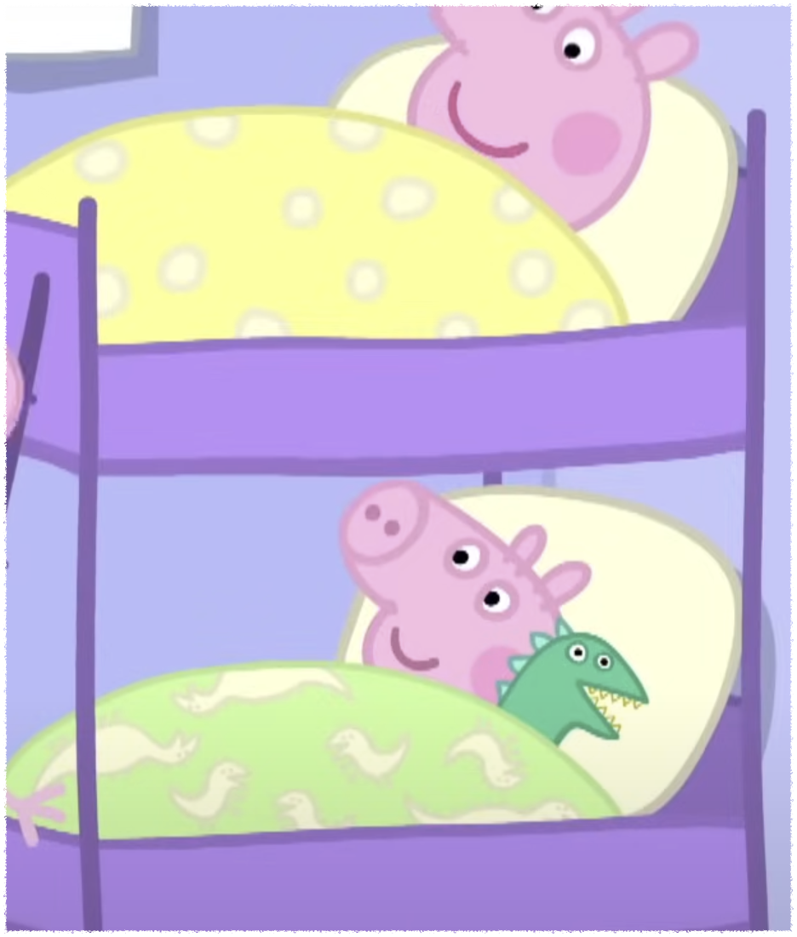
B b
Bath
Bed
Notes:
When George goes to bed,Mr dinosaur is tucked up with him

Slide 10


N n
Night
Mud
Notes:
Good night

Slide 11
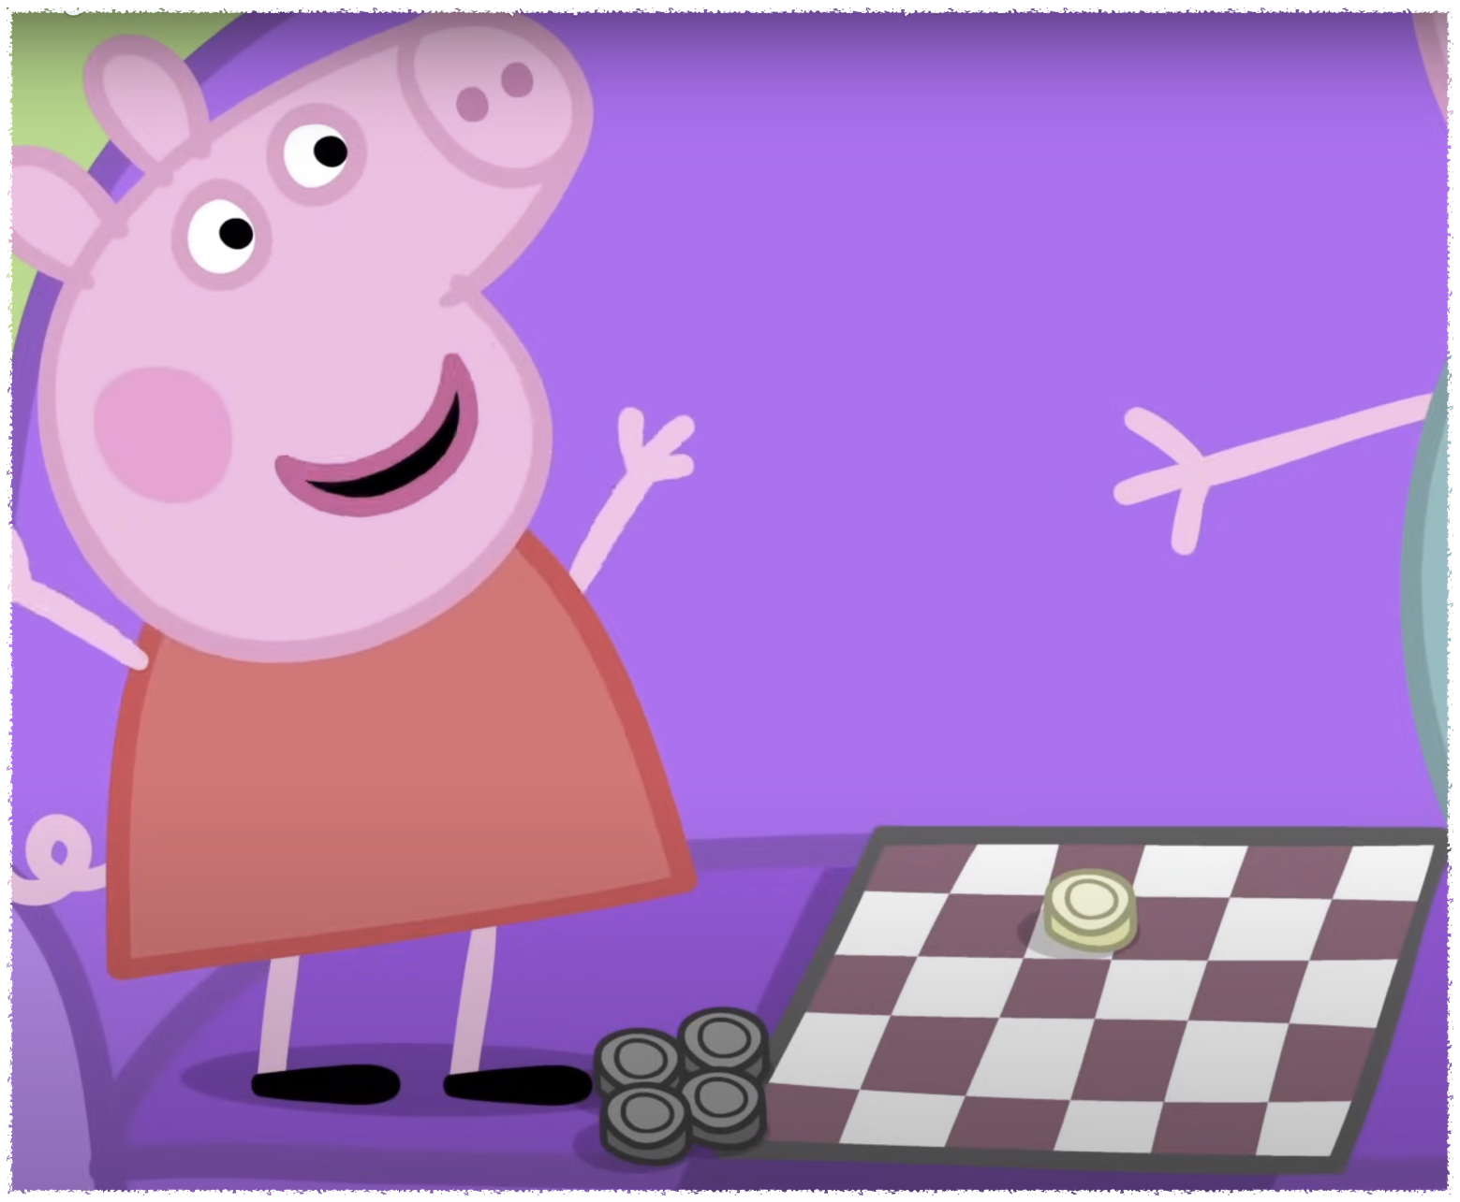
W w
Win
Notes:
I win daddy

